Slide 1
Unit III
Cloud Infrastructure
Architectural Design of Compute and Storage Clouds
Layered Cloud Architecture Development
Design Challenges CAT 1 PORTION
Inter Cloud Resource Management
Resource Provisioning and Platform Deployment
Global Exchange of Cloud Resources

Slide 2
Architectural Design of Compute and Storage Clouds
A Generic Cloud Architecture Design Cloud architecture is intended to process massive amounts of data with a high degree of parallelism.
The following are the major design goals of a cloud architecture: (4 Marks)
Scalability – cloud can be easily expanded by adding more servers and enlarging the network connectivity accordingly.
Virtualization - The cloud management software needs to support both physical and virtual machines
Efficiency - The hardware and software systems are combined to make it easy and efficient to operate.
Reliability - Data can be put into multiple locations. In such a situation, even if one of the data centers crashes, the user data is still accessible.

Slide 3
Security in shared resources and shared access of data centers also pose another design challenge. Clouds support Web 2.0 applications.Cloud management receives the user request, finds the correct resources, and then calls the provisioning services which invoke the resources in the cloud.
Enabling Technologies for Clouds
The key driving forces behind cloud computing are the ubiquity( presence everywhere) of broadband and wireless networking, falling storage costs, and progressive improvements in Internet computing software.
Cloud users are able to demand more capacity at peak demand, reduce costs, experiment with new services, and remove unneeded capacity, whereas service providers can increase system utilization via multiplexing, virtualization, and dynamic resource provisioning

Slide 4
Cloud-Enabling Technologies in Hardware, Software, and Networking (4 marks) (virtualisation, networking, data storage systems( servers and data centers ), and automation technologies)
Fast platform Deployment -flexible deployment of cloud resources
Virtual clusters on demand -to be provided and cluster need to be reconfigured as workload changes
Multitenant techniques –refers distributing software to a large no of users simultaneously
Massive data processing –internet search and web services required this process
Web-scale communication – support for e-commerce, education, social networking, medical care etc.
Distributed storage –large scale storage of data in distributed storage Licensing and billing services

Slide 5
Rapid progress in multicore CPUs, memory chips, and disk arrays has made it possible to build faster data centers with huge amounts of storage space. Resource virtualization enables rapid cloud deployment and disaster recovery.
Service-Oriented Architecture (SOA) is a software design approach that structures applications using self-contained, modular components called services.
Service-oriented architecture (SOA) also plays a vital role. Today’s clouds are designed to serve a large number of tenants over massive volumes of data. The availability of large-scale, distributed storage systems is the foundation of today’s data centers. Of course, cloud computing is greatly benefited by the progress made in license management and automatic billing techniques in recent years.

Slide 6
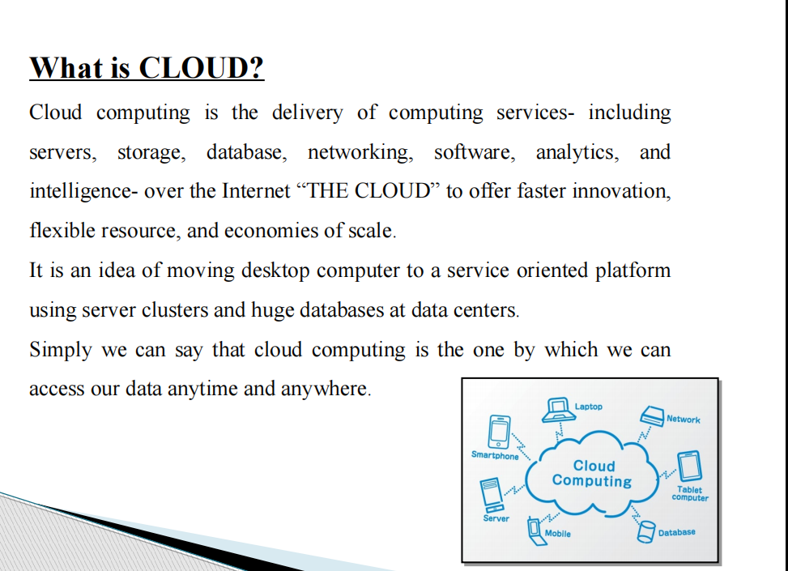

Slide 7
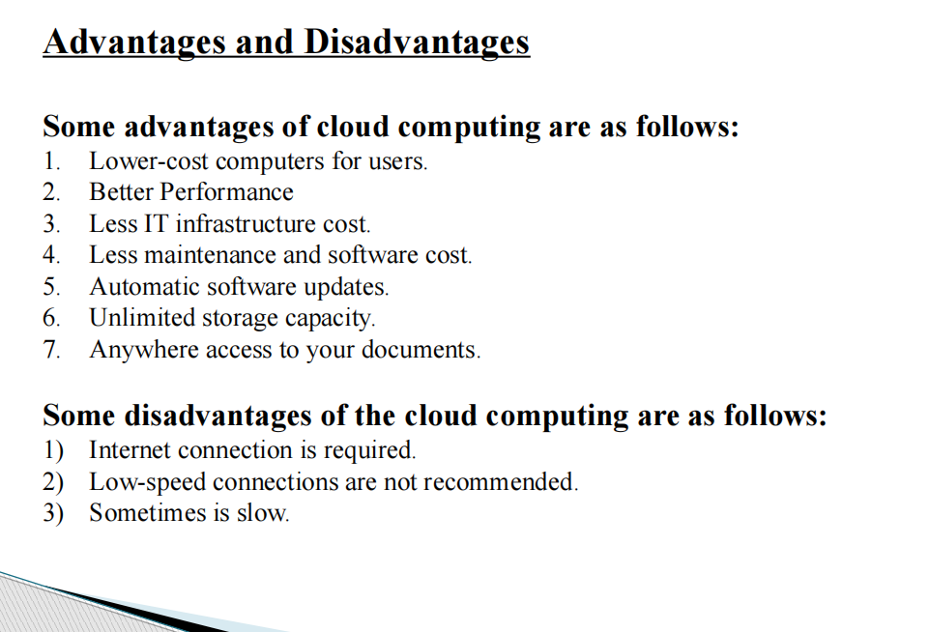

Slide 8
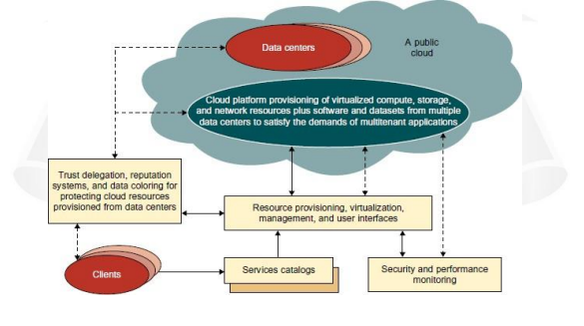
A Generic Cloud Architecture(12 Marks)

Slide 9
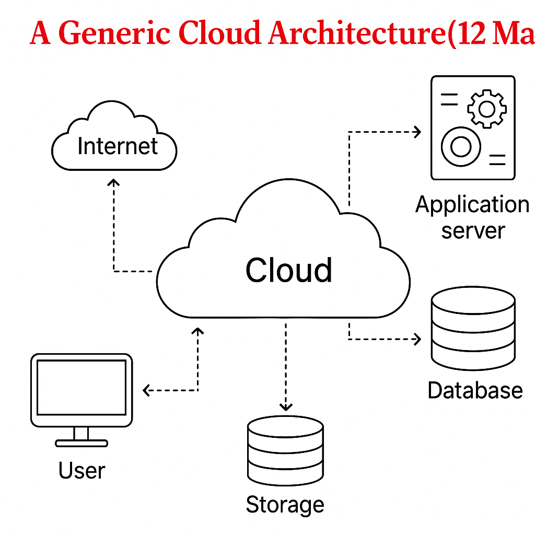

Slide 10
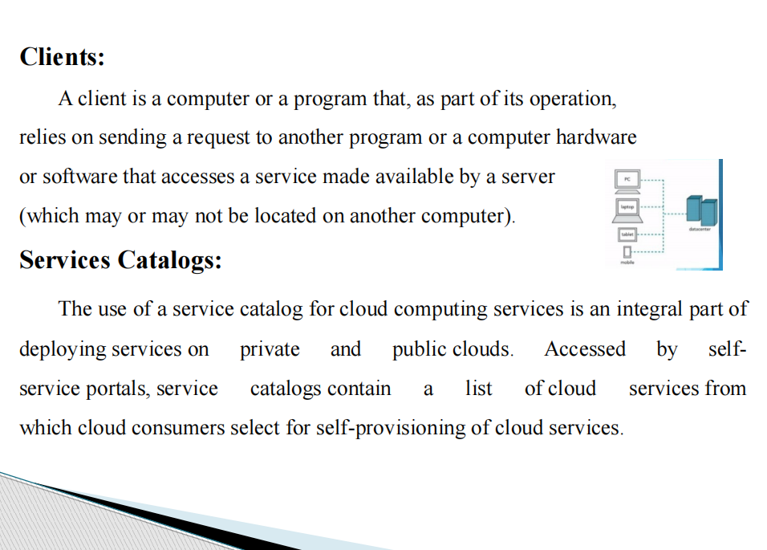

Slide 11
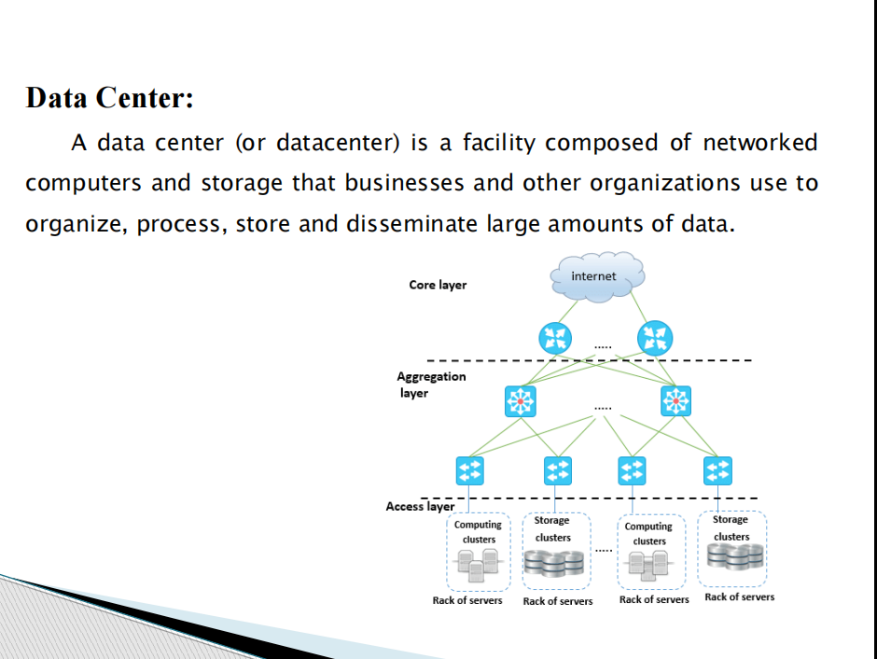

Slide 12
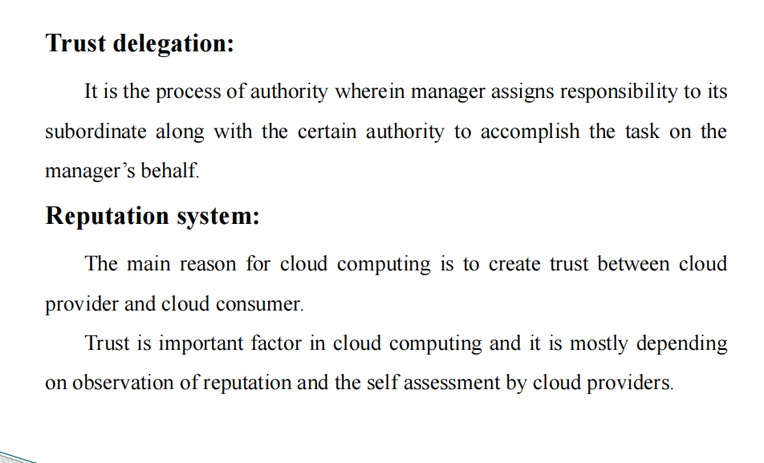

Slide 13
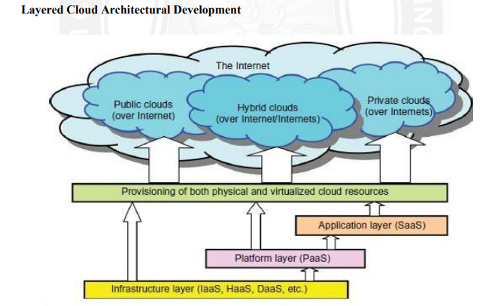
Layered Cloud Architectural Development 12M
The architecture of a cloud is developed at three layers: infrastructure, platform, and application, as demonstrated in figure.

Slide 14
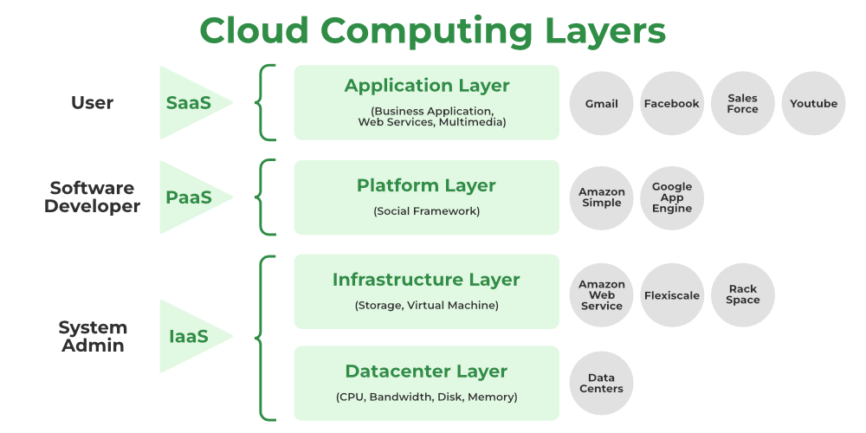

Slide 15
The architecture of a cloud is developed at three layers
➢Infrastructure
➢Platform
➢Application
Infrastructure Layer
Foundation for building the platform layer.
Built with virtualized compute, storage, and network resources.
Provide the flexibility demanded by users.
Virtualization realizes automated provisioning of resources and optimizes the infrastructure management process.

Slide 16
Platform Layer
Foundation for implementing the application layer for SaaS applications.
Used for general-purpose and repeated usage of the collection of software resources.
Provides users with an environment to develop their applications, to test operation flows, and to monitor execution results and performance.
Application Layer
Collection of all needed software modules for SaaS applications.
Service applications in this layer include daily office management work, such as information retrieval, document processing, and authentication services.
Many applications may apply resources at mixed layers.
Three layers are built from the bottom up with a dependence relationship.
Not all cloud services are restricted to a single layer.

Slide 17
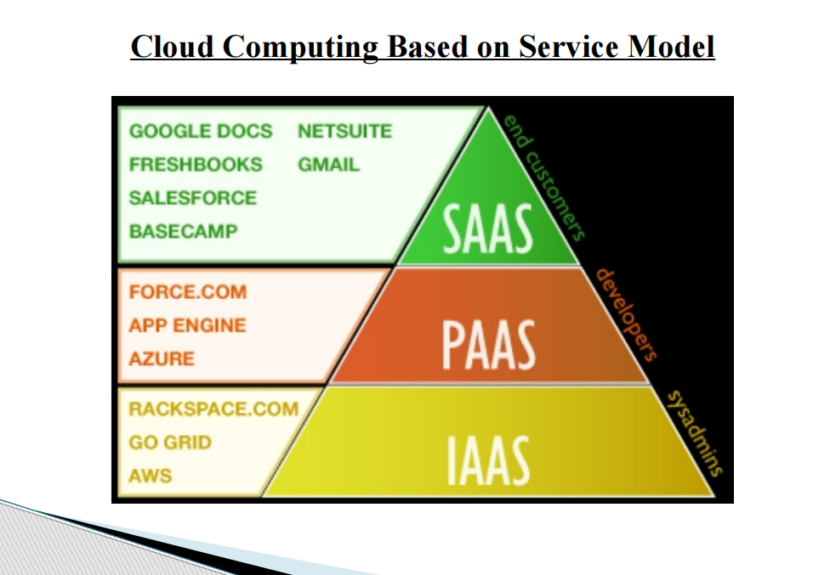

Slide 18
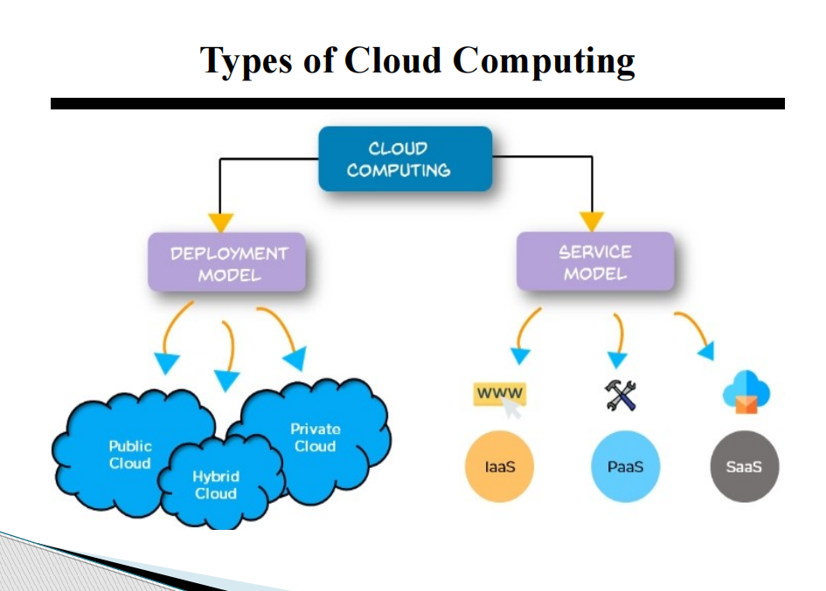

Slide 19
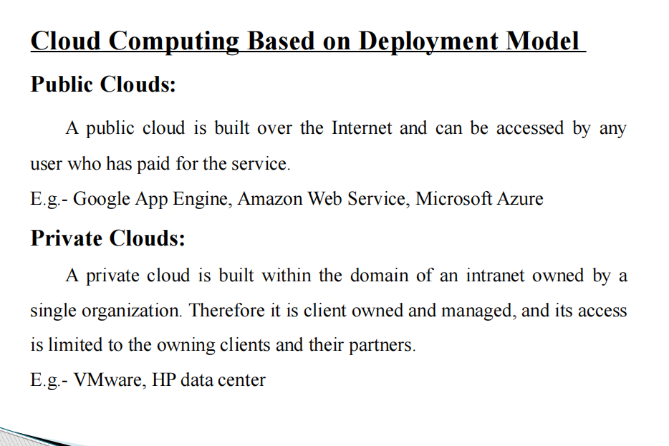

Slide 20
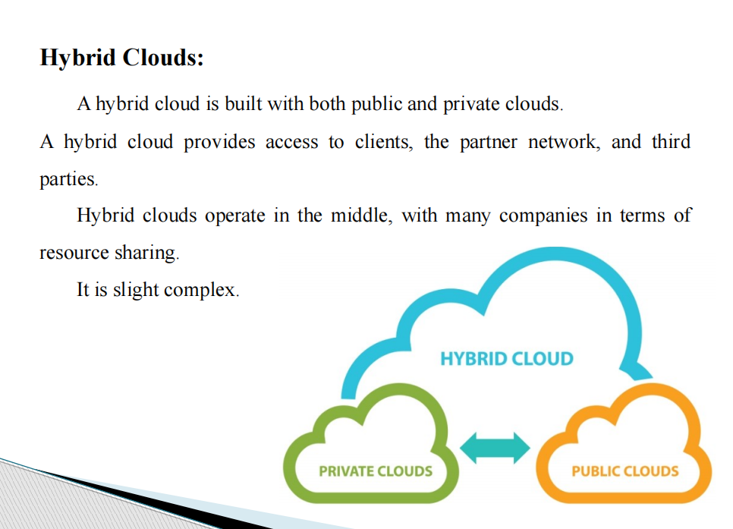

Slide 21
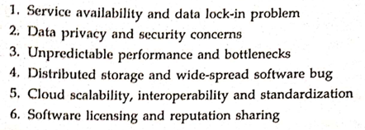
Design challenges
Cloud computing is the provisioning of resources like data and storage on demand, that is in real-time.
It has been proven to be revolutionary in the IT industry with the market valuation growing at a rapid rate.
Cloud development has proved to be beneficial not only for huge public and private enterprises but small-scale businesses as well as it helps to cut costs.

Slide 22
1.Scalability and Elasticity:
Dynamic Resource Allocation: Designing systems that can automatically scale resources based on demand without compromising performance or incurring unnecessary costs.
Load Balancing: Creating effective load balancing mechanisms to evenly distribute incoming traffic across multiple servers or instances.
2.Reliability and Fault Tolerance:
Redundancy and Data Replication: Developing strategies to ensure high availability by replicating data across multiple locations or employing redundant systems.
Disaster Recovery Planning: Designing architectures that can quickly recover from system failures or disasters without significant downtime.

Slide 23
3.Security and Compliance:
Data Encryption and Access Control: Implementing robust encryption methods and access control mechanisms to safeguard sensitive data.
Compliance Management: Designing architectures that comply with various regulatory standards and ensuring data governance and privacy.
4.Cost Optimization:
Resource Utilization: Designing systems that optimize resource utilization to minimize costs while maintaining performance.
Monitoring and Optimization Tools: Developing tools and methodologies for continuous monitoring and optimization of cloud resources to avoid unnecessary expenses.

Slide 24
5.Hybrid and Multi-Cloud:
Interoperability and Portability: Designing architectures that can seamlessly operate across multiple cloud platforms or in hybrid environments.
Data Consistency and Integration: Ensuring data consistency and smooth integration between different cloud environments or on-premises systems.

Slide 25
6.Performance Optimization:
• Latency and Bandwidth Management: Addressing challenges related to minimizing latency and efficiently managing bandwidth in distributed cloud architectures.
• Caching and Content Delivery: Implementing strategies for caching frequently accessed data and optimizing content delivery networks (CDNs) for improved performance.
7.Automated Management and Orchestration:
• Automation Frameworks: Designing frameworks for automated provisioning, configuration, and management of cloud resources.
• Orchestration (Arrangement of Tools): Implementing orchestration tools for coordinating complex workflows and services within the cloud architecture.

Slide 26
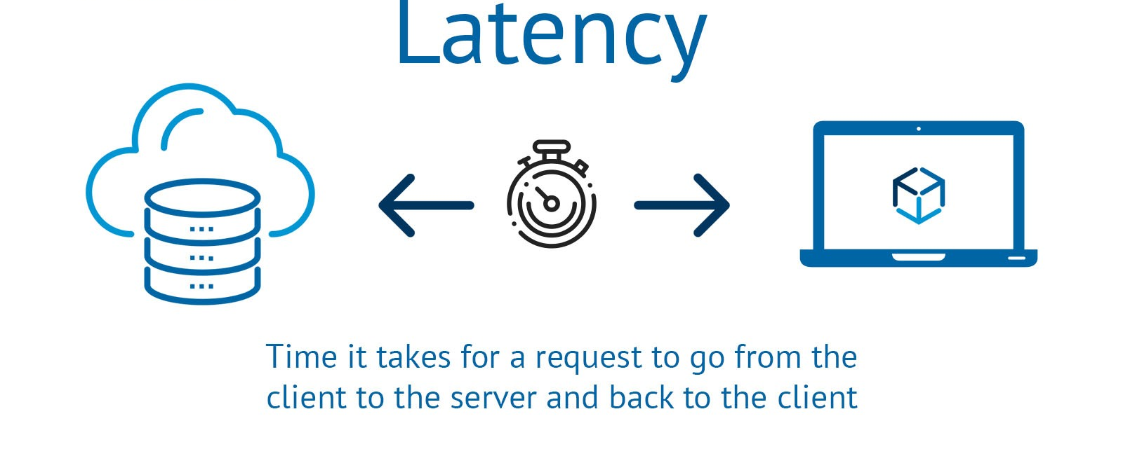

Slide 27
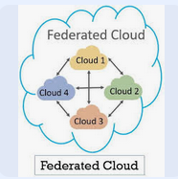
Inter-Cloud Resource Management (the process of managing resources across multiple interconnected clouds, including private, public, and hybrid clouds, as if they were a single.)
A cloud’s infrastructure’s processing and storage capacity could be exhausted.
combining numerous various separate clouds into a single fluid mass for on-demand operations.
Types of Inter-Cloud Resource Management:(12 Marks)
1.Federation Clouds:
A federation cloud is a kind of inter-cloud where several cloud service providers willingly link their cloud infrastructures together to exchange resources.
Cloud service providers in the federation trade resources in an open manner.
With the aid of this inter-cloud technology, private cloud portfolios, as well as government clouds (those utilized and owned by non-profits or the government), can cooperate.

Slide 28
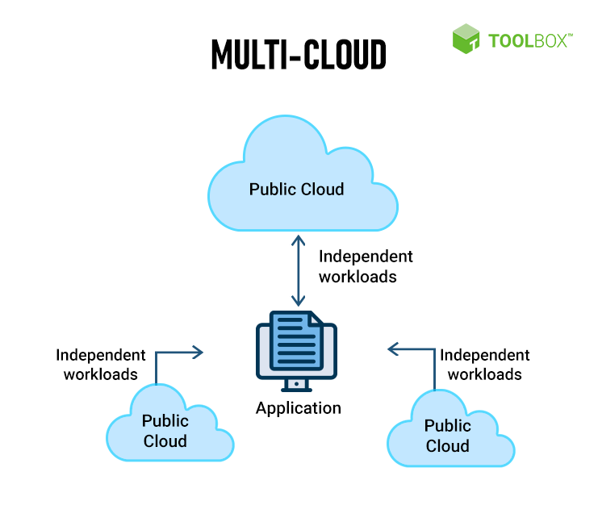
2.Multi-Cloud:
A client or service makes use of numerous independent clouds in a multi-cloud.
A multi-cloud ecosystem lacks voluntarily shared infrastructure across cloud service providers.
It is the client’s or their agents’ obligation to manage resource supply and scheduling.
This strategy is utilized to use assets from both public and private cloud portfolios.
These multi-cloud kinds include services and libraries.

Slide 29
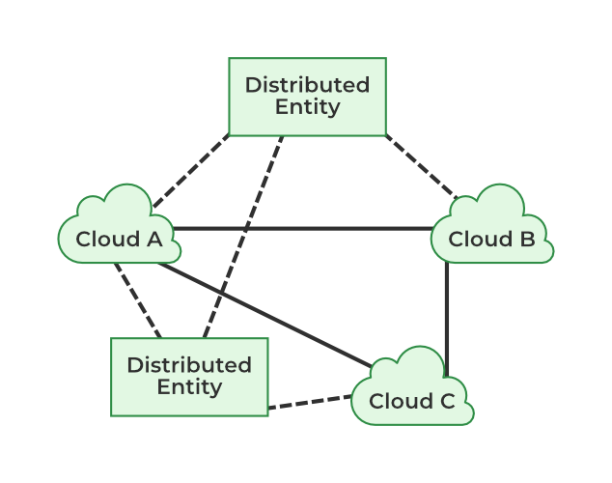
Topologies used In InterCloud Architecture
1.Peer-to-Peer Inter-Cloud Federation:
Clouds work together directly, but they may also utilize distributed entities as directories or brokers.
Clouds communicate and engage in direct negotiation without the use of intermediaries.
The peer-to-peer federation intercloud projects are RESERVOIR (Resources and Services Virtualization without Barriers Project).

Slide 30
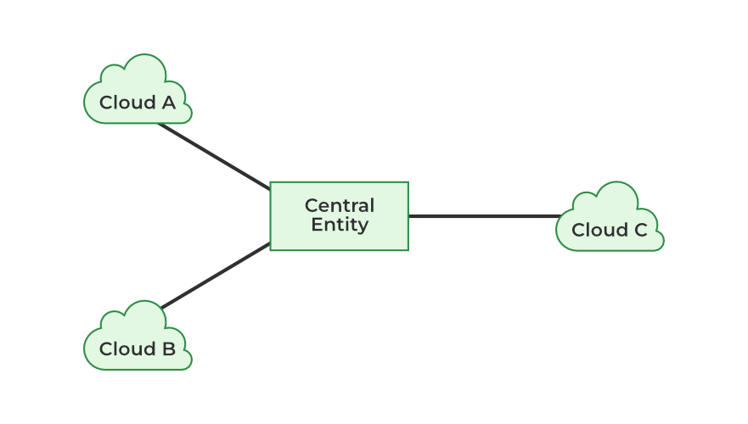
2.Centralized Inter-Cloud Federation:
In the cloud, resource sharing is carried out or facilitated by a central body.
The central entity serves as a registry for the available cloud resources.
The inter-cloud initiatives Dynamic Cloud Collaboration (DCC), and Federated Cloud Management leverage centralized inter-cloud federation.

Slide 31
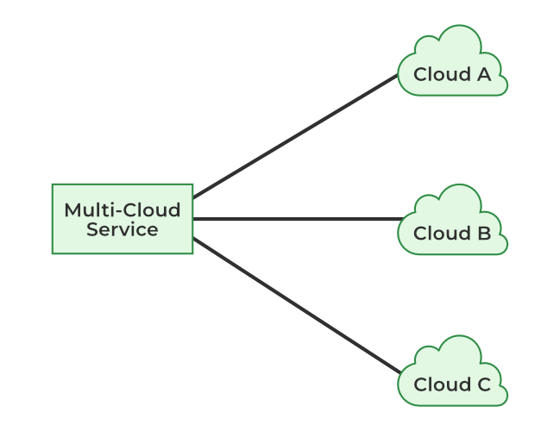
3.Multi-Cloud Service:
Clients use a service to access various clouds.
The cloud client hosts a service either inside or externally.
The services include elements for brokers. The inter-cloud initiatives OPTIMUS, contrail, MOSAIC, STRATOS, and commercial cloud management solutions leverage multi-cloud services.

Slide 32
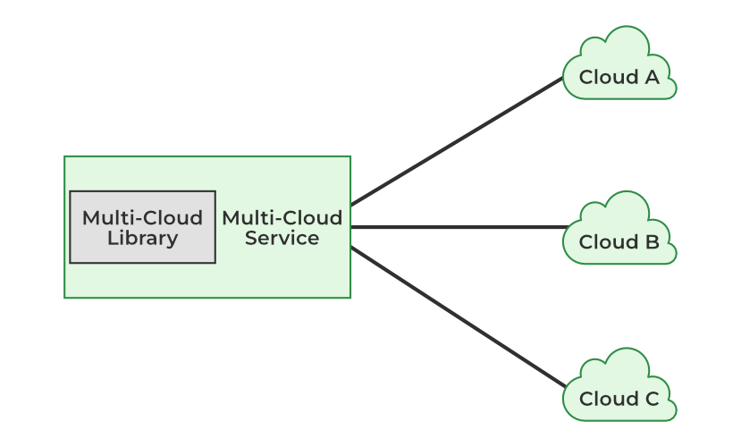
4.Multi-Cloud Libraries:
These libraries offer a common interface for accessing various cloud services, allowing developers to write code once and deploy it across different cloud providers without significant code changes.
Multi-cloud libraries refer to software development kits (SDKs) and tools that enable applications to interact with and manage resources across multiple cloud providers (e.g., AWS, Azure, Google Cloud).
Inter clouds that employ libraries make it easier to use clouds consistently.
Java library J-clouds, Python library Apache Lib-Clouds, and Ruby library Apache Delta-Cloud are a few examples of multiple multi-cloud libraries.

Slide 33
Resource Provisioning and Platform Deployment
Resource provisioning and platform deployment are crucial aspects of setting up and managing software applications and services in the digital landscape.
Resource provisioning refer to process of allocating and managing the necessary computing resources (such as virtual machines, storage, networks, etc.) to support the operation of an application or service.
This process ensures that the required resources are available and appropriately configured to meet the demands of the application, whether it's for scaling, performance, or other operational needs.

Slide 34
Here are some key steps involved in resource provisioning and platform deployment:
1.Resource Identification:
Determine the specific resources needed for the application, considering factors like computing power, storage requirements, network capacity, etc.
2.Resource Allocation:
Once identified, allocate the necessary resources, which might involve provisioning virtual machines, containers, or cloud-based services from providers like AWS, Azure, Google Cloud, etc.
3.Configuration Management:
Configure the allocated resources according to the application's requirements. This could involve setting up networking, security, access controls, and other configurations.

Slide 35
4.Deployment Strategy:
Plan how the application or software will be deployed. This includes choosing the deployment model (e.g., on-premises, cloud, hybrid), selecting deployment tools, and defining rollout strategies (e.g., canary deployment, blue-green deployment).
5.Automated Deployment:
Utilize automation tools (like Ansible, Puppet, Github, Chef, Kubernetes, Docker, etc.) to streamline the deployment process, ensure consistency, and minimize human error.
6.Monitoring and Optimization:
After deployment, continuously monitor the platform's performance, resource utilization, and application health.
This enables optimization by scaling resources up or down based on demand and making adjustments to improve efficiency and reliability.

Slide 36
7.Security Measures:
Implement robust security measures throughout the provisioning and deployment process to protect against potential threats and vulnerabilities.
Id All Man Depl Auto Monitor Sec:
By effectively managing resource provisioning and platform deployment, organizations can ensure the efficient operation of their applications or services, maintain scalability, and adapt to changing demands in the digital landscape.

Slide 37
Global exchange of cloud resources: Refers to the sharing and utilization of computing, storage, and other cloud-based services across different cloud platforms and geographical locations.
Introduction
Cloud Exchange (CEx) serves as a market maker, bringing service providers and users together. The University of Melbourne proposed it under Intercloud architecture (Cloudbus).
It supports brokering and exchanging cloud resources for scaling applications across multiple clouds. It aggregates the infrastructure demands from application brokers and evaluates them against the available supply.
It supports the trading of cloud services based on competitive economic models such as commodity markets and auctions.

Slide 38
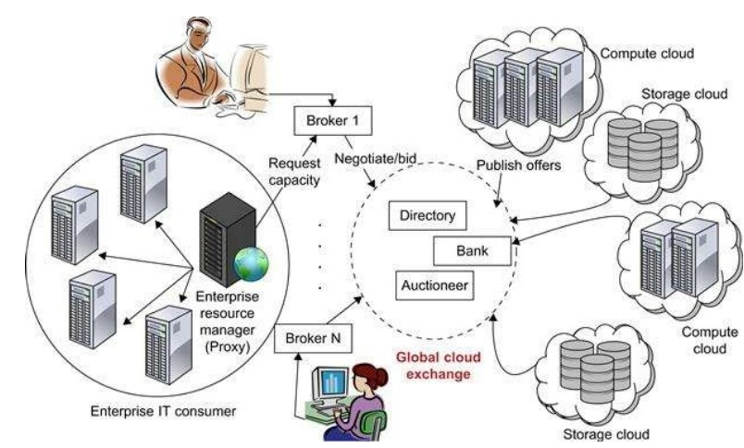

Slide 39
Entities of the Global exchange of cloud resources
Now we will talk about the various entities of the global exchange of cloud resources.
Market directory
A market directory is an extensive database of resources, providers, and participants using the resources. Participants can use the market directory to find providers or customers with suitable offers.
Auctioneers : auctioneers are entities that facilitate the allocation of resources, like virtual machines or network bandwidth, through a bidding process.
Auctioneers clear bids and ask from market participants regularly. Auctioneers sit between providers and customers and grant the resources available in the Global exchange of cloud resources to the highest bidding customer.

Slide 40
Brokers
Brokers mediate between consumers and providers by buying capacity from the provider and sub-leasing these to the consumers. They must select consumers whose apps will provide the most utility. Brokers may also communicate with resource providers and other brokers to acquire or trade resource shares. To make decisions, these brokers are equipped with a negotiating module informed by the present conditions of the resources and the current demand.

Slide 41
Service-level agreements(SLAs)
The service level agreement (SLA) highlights the details of the service to be provided in terms of metrics that have been agreed upon by all parties, as well as penalties for meeting and failing to meet the expectations.
The consumer participates in the utility market via a resource management proxy that chooses a set of brokers based on their offering. SLAs are formed between the consumer and the brokers, which bind the latter to offer the guaranteed resources. After that, the customer either runs their environment on the leased resources or uses the provider's interfaces to scale their applications.

Slide 42
Providers
A provider has a price-setting mechanism that determines the current price for their source based on market conditions, user demand, and the current degree of utilization of the resource.
Based on an initial estimate of utility, an admission-control mechanism at a provider's end selects the auctions to participate in or to negotiate with the brokers.
Resource management system
The resource management system provides functionalities such as advance reservations that enable guaranteed provisioning of resource capacity.

